Slide 1
Module 4
INTERACTION DESIGN MODELS

Slide 2
Introduction
Predictive models such as the Model Human Processor (MHP) and the Keyboard Level Model (KLM), are a priori (pre-experience) models
  They give approximations of user actions before real users are brought into the testing environment.
Descriptive models such as state networks and the Three-State Model, provide a framework for thinking about user interaction
  They can help us to understand how people interact with dynamic systems.

Slide 3
Model Human Processor (MHP)
The MHP is a predictive model and is described by a set of memories and processors that function according to a set of principles (principles of operation).
MHP helps in designing user-friendly interfaces by understanding human cognitive capabilities and limitations.
The Model Human Processor can make general predictions about human performance.

Slide 4
Key Components of MHP
MHP consists of three primary subsystems, each with its own processor and memory:
Perceptual System
  Processes sensory inputs (vision, hearing, touch, taste).
  Converts external stimuli into meaningful patterns.
  Key factors: Visual acuity, auditory perception, and haptic feedback.
Cognitive System
  Interprets information and makes decisions.
  Retrieves information from memory.
  Key functions: Thinking, reasoning, problem-solving, and learning.
Motor System
  Executes physical actions based on cognitive decisions.
  Involves muscle movements for tasks like typing, clicking, or gestures.
  Key factors: Reaction time, muscle memory, and coordination.

Slide 5
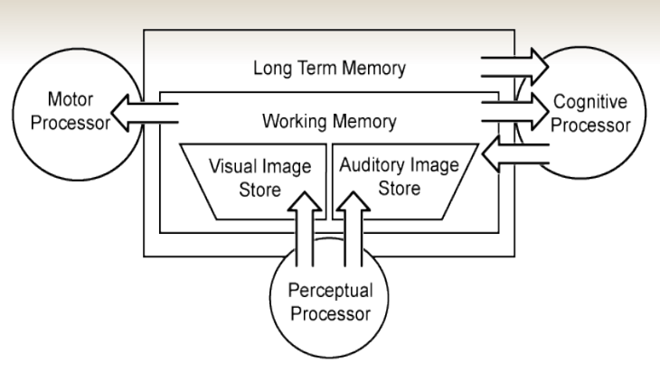
Model Human Processor (MHP)

Slide 6
Model Human Processor (MHP)
Perceptual system (sensory image stores)
  Sensors
    eyes, ears, touch, taste
  Buffers
    Visual memory store (VIS)
    Auditory memory store (AIS)
    Haptic Memory Store (HIS)
    Taste Memory Store (TIS)
Cognitive system
    Working memory (WM)
    Short-term memory
    Long-term memory (LTM)
Motor system
    arm-hand-finger system
    head-eye system
    leg-foot-toe system

Slide 7

MHP – Working Memory
WM consists of a subset of “activated” elements from LTM (long term memory)
The SISs (Sensory Image Store, VIS, AIS..) encode only the non-symbolic physical parameters of stimuli.
The Sensory Image Store (SIS) captures raw sensory data before converting it into symbols.
  Ex: VIS processes images/icons before recognizing them as meaningful symbols.
  AIS holds sounds before users interpret them as words or commands.
Shortly after seeing or hearing a stimulus, WM converts it into a symbolic form, making it easier to process.
  Ex: Seeing a red button with a trash icon → Recognizing
  it as a delete action.

Slide 8
MHP – Working Memory
Working Memory (WM) holds "activated elements" from Long-Term Memory (LTM)..
The activated elements from LTM are called chunks.
  Chunks are meaningful units of information grouped together for easier processing
  Chunks can be composed of smaller units like the letters in a word
  A chunk might also consist of several words, as in a well-known phrase
Chunks in WM can interfere with each other due to LTM associations
Similar chunks stored in LTM can create confusion in WM due to associations.
  Example: If a UI uses similar icons for "Save" and "Submit," users may mix them up.

Slide 9
MHP – Long-Term Memory
The cognitive processor can add items to WM but not to LTM
The WM must interact with LTM over a significant length of time before an item can be stored in LTM
This increases the number of cues that can be used to retrieve the item later
Items with numerous associations have a greater probability of being retrieved

Slide 10
MHP – Processor Timing
Perceptual—The perceptual system captures physical sensations by way of the visual and auditory receptor channels
Perceptual decay is shorter for the visual channel than for the auditory channel
Perceptual processor cycle time is variable according to the nature of the stimuli Perceptual
Processor cycle time = [50-200] msecs (approx. 0.2 sec)

Slide 11
MHP – Processor Timing
Cognitive—The cognitive system bridges the perceptual and motor systems
It can function as a simple conduit or it can involve complex processes, such as learning, fact retrieval, and problem solving
Cognitive coding in the WM is predominantly visual and auditory

Slide 12
MHP – Processor Timing
Cognitive coding in LTM is involved with associations and is considered to be predominantly semantic
Cognitive decay time of WM requires a large range
Cognitive decay is highly sensitive to the number of chunks involved in the recalled item
Learning occurs through cognitive memory structures, which perceive, process, store for short- or long-term recall and retrieve information, located in the brain. Learning occurs through internal processing of information.

Slide 13
MHP – Processor Timing
Cognitive decay of LTM is considered infinite
Cognitive processor cycle time is variable according to the nature of the stimuli
Motor—The motor system converts thought into action
Motor processor cycle time is calculated in units of discrete micro-movements

Slide 14
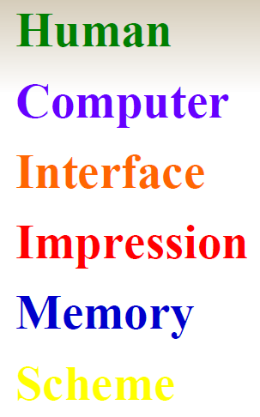
Cognition Example
Perception/LTM interaction
Read out the colours and time it T1

Slide 15
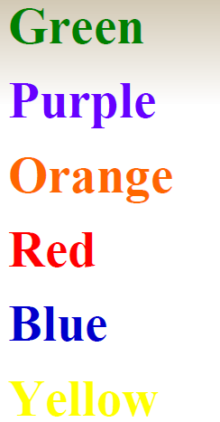
Cont..
Perception Speed: Time it, T2, T1 > T2

Slide 16
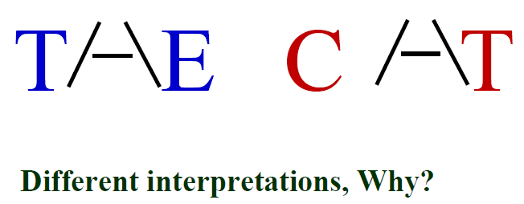
Cont..
Memory is Associative

Slide 17
Model Human Processor (MHP)

Slide 18
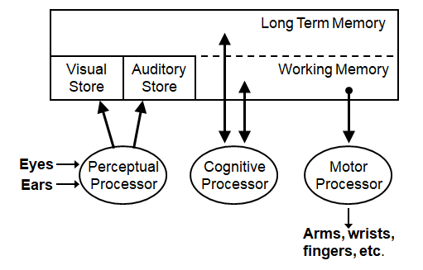
Model Human Processor (MHP)

Slide 19
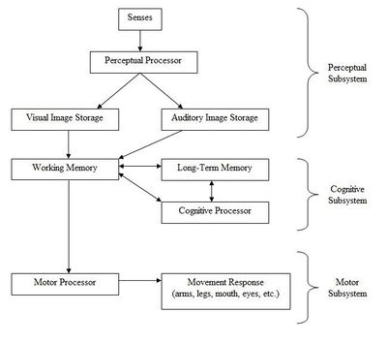
Model Human Processor (MHP)

Slide 20
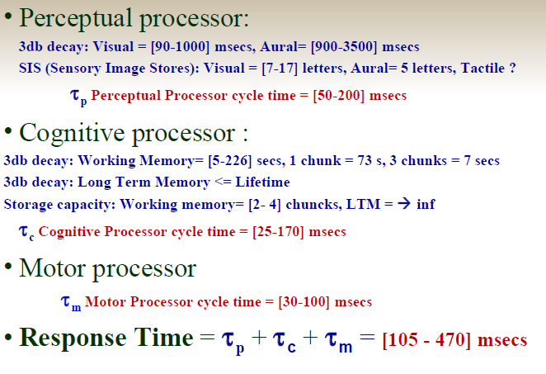
Timing values: Human Processor Model

Slide 21
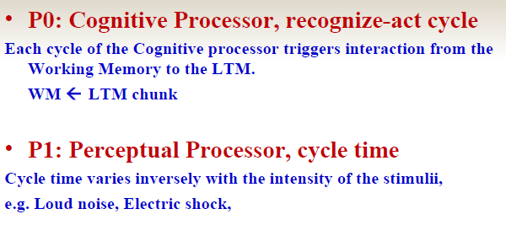
MHP – Principles of Operation

Slide 22
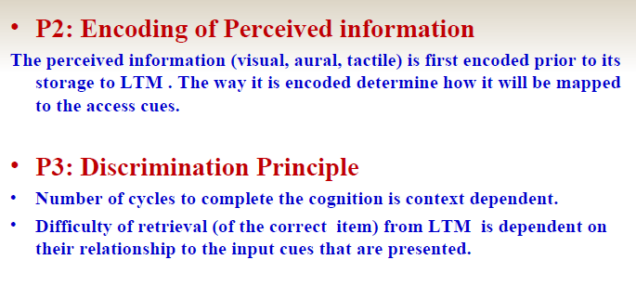
MHP – Principles of Operation

Slide 23
MHP – Principles of Operation
P4: Cognitive Processor Rate
Variable Rate Principle
Cycle time Tc is shorter when greater effort is induced by increased task demands or information loads; it also diminishes with practice.
Cognitive processing becomes faster
  Under increased task demands (e.g. panic situations)
  After practice

Slide 24
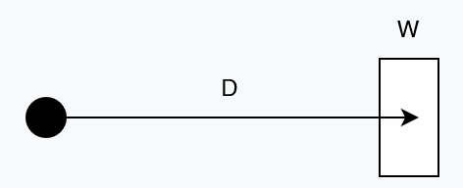
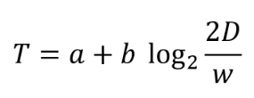
MHP – Principles of Operation
P5 : Fitt’s Law
The relationship between the time it takes a pointer (such as a mouse cursor, a human finger, or a hand) to move to a particular target (e.g., physical or digital button, a physical object) in order to interact with it in some way (e.g., by clicking or tapping it, grasping it, etc.)
D is the distance to the target, w is the width of the target (technically, measured along the axis of movement), and a and b are constants that vary depending on the type of pointer (e.g., mouse, finger, etc.).

Slide 25

MHP – Principles of Operation
P6: Power Law of Practice
The time T_{n} to perform a task on the n^{th} trial follows a power law.
Performance Gain: due to repeated practice
  where n is the number of attempts,
  T₁ the initial time,
  T_{n} the time at the n^{th} repetition.

Slide 26
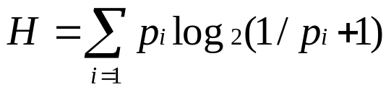
MHP – Principles of Operation
P7: Uncertainty Principle
  Decision time increases with the uncertainty about the judgment to be made, requires more cognitive cycles
Hicks Law - Choice Reaction Time
  Models human reaction time under uncertainty
  Decision time T increases with uncertainty about the judgment or decision to be made
  T = I_{c}H, where H is the entropy of the decision and I_{c} = 150 [0 – 157].
  H = log₂(n + 1), if n probabilities are equal
  For, n probabilities are different, p_{i} of occurrence

Slide 27
MHP – Principles of Operation
P8 : Rationality Principle
People act so as to attain their goals through rational action, given the structure of the task and their inputs of information and bounded by limitations on their knowledge and processing abilities:
goals + task + operators + inputs + knowledge + processing limits -> behavior
Rational action -> Emotion and motivation
individuals use their self-interests to make choices that will provide them with the greatest benefit.

Slide 28
MHP – Principles of Operation
P9 : Problem Space Principle
The rational activity in which people engage to solve a problem can be described in terms of
  a set of states of knowledge
  operators for changing one state into another
  constraints on applying operators
  control knowledge for deciding which operator to apply next

Slide 29
Keyboard Level Model (KLM)
The KLM is a practical design tool that can capture and calculate the physical actions a user will have to carry out to complete specific tasks
The KLM can be used to determine the most efficient method and its suitability for specific contexts

Slide 30
Keyboard Level Model (KLM)
Given:
– A task (possibly involving several subtasks)
– The command language of a system
– The motor skill parameter of the user
– The response time parameters
Predict: The time an expert user will take to execute the task using the system
– Provided that he or she uses the method without error

Slide 31
Keyboard Level Model (KLM)
The KLM is comprised of:
  – Operators
  – Encoding methods
  – Heuristics for the placement of mental (M) operators

Slide 32
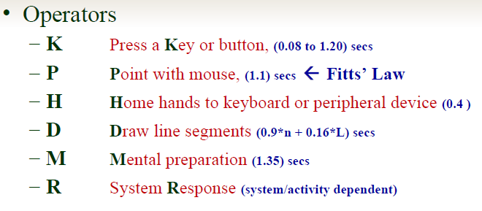
KLM - Operators

Slide 33
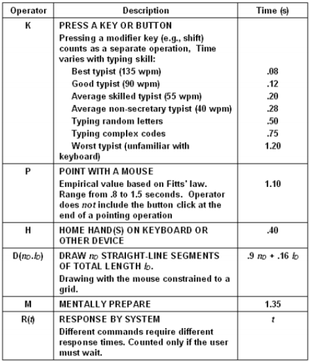

Slide 34
KLM – Encoding Methods
Encoding methods define how the operators involved in a task are to be written, e.g., ‘ipconfig’ with Command Line Interface in a command window:
MK[i]K[p]K[c]K[o]K[n]K[f]K[i]K[g]K[RETURN]
It would be encoded in the short-hand version as
M 9K[ipconfig RETURN]
This results in a timing of 1.35+9*0.20 = 2.95 seconds for an average skilled typist.
Using Windows: Network -> Repair option (Home wireless)
H[mouse]MP[Network Icon]K[Right click]P[Prepare]K[Left Click]
Time = 4.35 secs.

Slide 35
KLM Example 2
Consider the scenario of correcting a
mirtake -> mistake
Move hand to mouse H[mouse]
Position mouse after the bad char PK[Left] //Pointing & Clicking to Move the Cursor Left
Return to keyboard H[keyboard]
Delete bad char MK[backspace]
Type in new char K[char]
Reposition the insertion point to the original position H[mouse]MPK[Left]
    Total time = 3*h+2*p+2*k+2*k+2*m
    =3*0.4+2(1.1+0.08+0.20+1.35)
    =1.2+2(2.73)
    =1.2+5.46
    =6.66 secs

Slide 36

Calculation of P: Pointing and Positioning Time
Based on Experimentation, average P = 1.1 secs
  A = distance from the target
  W = Width (cross-section) of the target
  a= 0, b = 0.1, a and b are constants that depend on the choice of input device and are usually determined empirically by regression analysis.
Example: Suppose the mouse is in the middle of a 19 cm screen and we have to move to a 2 cm wide tool bar at the top of the screen then the time taken will be,

Slide 37
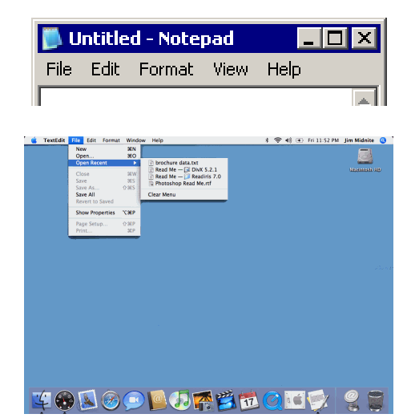
Menu selection: Macintosh OS vs. Windows
Menu placement:
Macintosh: Aligned with the edge (No offset) ->
  Users need not be very accurate when hitting the target. Typically, they stop 50 mm from the edge
Windows: Offset by the Title bar (pull down) ->
  Need more accuracy as the Width of target is 5 mm.

Slide 38
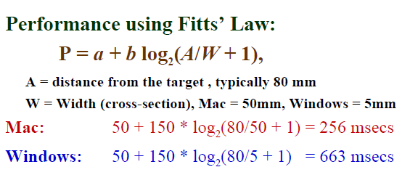
Menu selection: Macintosh OS vs. Windows

Slide 39
KLM – Heuristics for M Operator Placement
The KLM operators can be placed into one of two groups— physical or cognitive.
The physical operators are defined by the chosen method of operation, such as clicking an icon or entering a command string.
The cognitive operators are governed by the set of heuristics

Slide 40
Rules for keeping/deleting the M operator
Rule 0:
  Place M in front of all K where you want to enter new text and all P (mouse) that selects commands.
Rule 1:
  If M is also associated with the previous operator, then delete it, e.g. PMK -> PK
Rule 2:
  If there is a string of M then delete all except the first.

Slide 41
Rules for keeping/deleting the M operator
Rule 3:
  If K is a redundant terminator then delete the M in front of it, e.g.
M<command> K M<argument> K ->
M<command> K <argument> K
Example:
Mstrcpy K Ms1 K Ms2 K => Mstrcpy K s1 K s2 K

Slide 42
Rules for keeping/deleting the M operator
Rule 4:
  Delete M, if K terminates a command string. Keep M, if K terminates an argument string, e.g.
  M<command> K -> <command> K
  Example:
  - Typing ls in a command-line interface and pressing Enter (used to list files).
  - Here, Enter (K) executes the command directly, and no additional cognitive effort is needed.
  M<argument> K -> M <argument> K
  Example:
  - Typing del filename.txt and pressing Enter.
  - The user thinks before pressing Enter (K) to confirm deletion.
  - Here, M is retained because the user processes the impact of the argument.

Slide 43
What the KLM Does Not Do
The KLM was not designed to consider the following:
    – Errors
    – Learning
    – Functionality
    – Recall
    – Concentration
    – Fatigue
    – Acceptability

Slide 44
Applications for the KLM
Case 1 (Mouse-Driven Text Editor)
  During the development of the Xerox Star KLMs served as expert proxies
Case 2 (Directory Assistance Workstation)
  The KLM clarified the tradeoffs between the number of keystrokes entered in the query and the number of returned fields

Slide 45
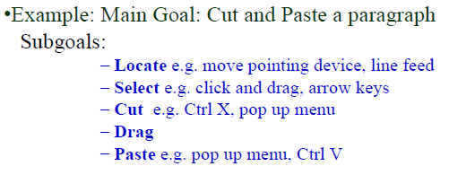
GOMS- Goals, Operators, Methods, Selection
Goal/task models can be used to explore the methods people use to accomplish their goals
Card et al. suggested that user interaction could be described by defining the sequential actions a person undertakes to accomplish a task.

Slide 46
GOMS Component
Goals - Tasks are deconstructed as a set of goals and subgoals.
Operators - Tasks can only be carried out by undertaking specific actions.
Methods - Represent ways of achieving a goal
  Comprised of operators that facilitate method completion
Selection Rules - The method that the user chooses is determined by selection rules

Slide 47
GOMS – CMN-GOMS
CMN-GOMS can predict behavior and assess memory requirements
CMN-GOMS (named after Card, Moran, & Newell) –a detailed expansion of the general GOMS model
  Includes specific analysis procedures and notation descriptions
Can judge memory requirements (the depth of the nested goal structures)
Provides insight into user performance measures

Slide 48
GOMS – Other GOMS Models
NGOMSL (Natural GOMS Language), developed by Kieras, provides a structured natural-language notation for GOMS analysis and describes the procedures for accomplishing that analysis (Kieras, 1997)
  NGOMSL Provides:
    A method for measuring the time it will take to learn specific method of operation
    A way to determine the consistency of a design’s methods of operation

Slide 49
GOMS – Other GOMS Models
CPM-GOMS represents
  Cognitive
  Perceptual
  Motor operators
CPM-GOMS uses Program Evaluation Review Technique (PERT- Program Evaluation Review Technique) charts
  Maps task durations using the critical path method (CPM).
CPM-GOMS is based directly on the Model Human Processor
  Assumes that perceptual, cognitive, and motor processors function in parallel

Slide 50
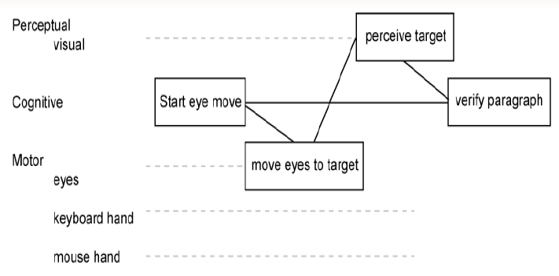
GOMS – Other GOMS Models
Program Evaluation Review Technique (PERT) chart Resource Flows

Slide 51
Modeling Structure
Structural models can help us to see the relationship between the conceptual components and the physical components of the system, allowing us to judge the design’s relative effectiveness.

Slide 52
Modeling Structure – Hick’s Law
Hick’s law can be used to create menu structures
Hick’s law states that the time it takes to choose one item from n alternatives is proportional to the logarithm (base 2) of the number of choices, plus 1.
This equation is predicated on all items having an equal probability of being chosen

Slide 53

Modeling Structure – Hicks Law
The coefficients are empirically determined from experimental design
Raskin (2000) suggests that
a =50 and b= 150
are sufficient place holders for “back-of-the envelope” approximations

Slide 54
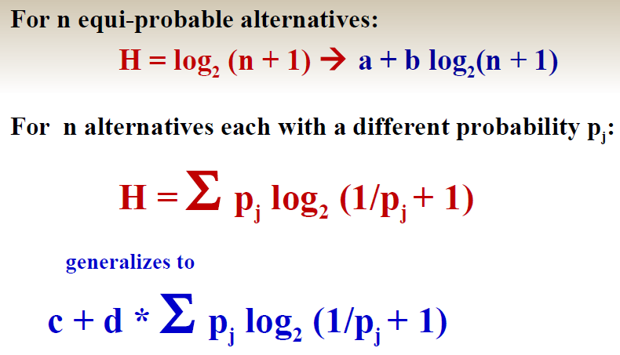
Modeling Structure – Other Forms of Hicks Law

Slide 55
Modeling Structure – Hicks Law
Menu listing order must be logical and relevant
Menus are lists grouped according to some predetermined system
If the rules are not understood or if they are not relevant to a particular task, their arrangement may seem arbitrary and random, requiring users to search in a linear, sequential manner.

Slide 56
Modeling Dynamics
Understanding the temporal aspects of interaction design is essential to the design of usable and useful systems
Interaction designs involve dynamic feedback loops between the user and the system
  User actions alter the state of the system, which in turn influences the user’s subsequent actions
Interaction designers need tools to explore how a system undergoes transitions from one state to the next

Slide 57
Modeling Dynamics – State Transition Networks
State Transition Networks can be used to explore:
  Menus
  Icons
  Tools
State Transition Networks can show the operation of peripheral devices

Slide 58
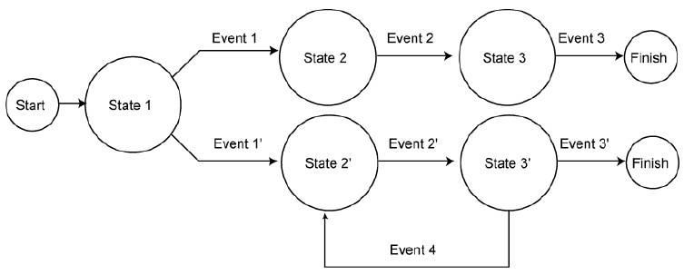
Modeling Dynamics – State Transition Networks
STNs are appropriate for showing sequential operations that may involve choice on the part of the user, as well as for expressing iteration.

Slide 59
Modeling Dynamics – Three-State Model
The Three-State Model can help designers to determine appropriate I/O devices for specific interaction designs
The TSM can reveal intrinsic device states and their subsequent transitions
  The interaction designer can use these to make determinations about the correlation between task and device
  Certain devices can be ruled out early in the design process if they do not possess the appropriate states for the specified task

Slide 60
Modeling Dynamics – Three-State Model
The Three-State Model (TSM) is capable of describing three different types of pointer movements
  Tracked: A mouse device is tracked by the system and represented by the cursor position
  Dragged: A mouse also can be used to manipulate screen elements using drag-and-drop operations
  Disengaged movement: Some pointing devices can be moved without being tracked by the system, such as light pens or fingers on a touch-screen, and then reengage the system at random screen locations. Also lift mouse, move and put it down.

